Slide 1


Traffic Camera Image Analysis System
Quadcore Productions
Demo One

Slide 2
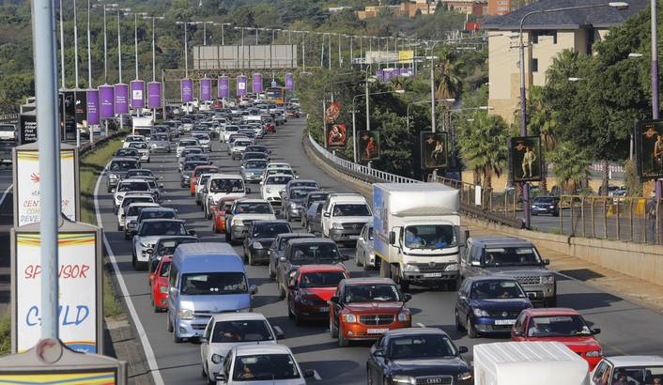
The Project
Create an application that outputs traffic information and alerts users of traffic in order to help users to avoid traffic on their daily routes
This will be done by running image analysis on images from highway cameras
Image source: SANRAL highway cameras - https://www.i-traffic.co.za/traffic/cameras.aspx
Any other open data sources of traffic cameras

Slide 3
Project Scope
On the front-end: The users will communicate with the system through an Android Application
On the back-end: There will be a web server which takes care of all the heavy processing and sends back information to the app
The web server will communicate with the app through GCM
So on each end, what takes place?
App
Server

Slide 4
Android Application
Route set-up
User specifies their daily routes
To be used in requests for traffic information from the web server
Notification scheduling
User sets the time they expect to be alerted at, e.g. By their usual departure or expected arrival time.
Viewing of traffic information
User should be able to view the traffic information returned by the server
Route optimization
Make use of traffic information and other metrics to determine best route for user to take

Slide 5
Web Server
Image Retrieval
Retrieve images from cameras on specified route
Using a web scraper written in Python
Image processing & image analysis
Perform image processing
Apply intelligence to determine the traffic situation in that area
Using OpenCV (neural network & machine learning libraries)
Report compilation
Create a report about the traffic on route to be sent to Android application
Cache information for a short period
Store information on route for short period till data is irrelevant
Using a cache server

Slide 6
Initial Software Architecture

Slide 7
What’s next?
Functional Requirements
Intensive Research
On traffic analysis, specifically - relevant algorithms and APIs
Other possible metrics for route optimization

